Slide 1
7773 Final Project —
Options Recommender
Stars Group: Zhizhou Ji, Qi Wu, Lisha Tong

Slide 2
What is Our Project？
We recommend options (S&P 500 ETF options) that are more profitable to users.
Are we predicting the prices of S&P 500? No, we predict option payoffs directly!
Thus, we leave the work of predicting the prices of S&P 500 to our users.
We use classification models (RandomForest) to predict which kind of options (ITM, ATM, OTM) are more likely to make profit under each expectation and different market circumstances.

Slide 3
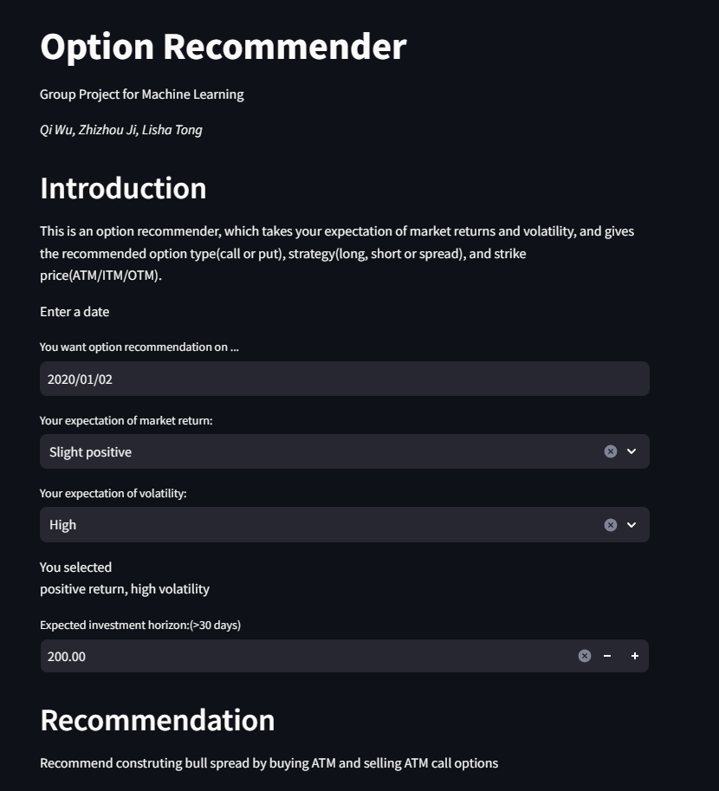
What is Our Project？
Users can choose their expectations of S&P return and volatility on our streamlit app.
Large Positive: Long Call
Slight Positive: Bull Spread/Short Put
Slight Negative: Short Call
Large Negative: Long Put
Our app returns to the users options that are more likely to be profitable based on our machine learning models.

Slide 4
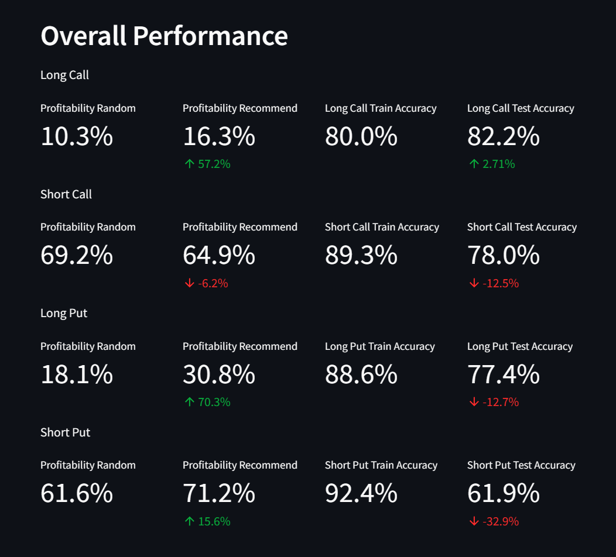
Our Models & Do They Work?
We used options data and macroeconomics data to train four classification models respectively.
Long Call
Short Put
Short Call
Long Put
On the test set, we compared the probabilities of profit with and without using our models.

Slide 5
Do They Really Work? (Or How They work?)
Before we start:
Our models make some smart decisions.
We'll capture the secrets of how to successfully invest in options.

Slide 6
Do They Really Work? (Or How They work?)
Before we start:
Our models make some smart decisions.
We'll capture the secrets of how to successfully invest in options.
After we finished:
Our models avoid some stupid decisions!
If the user expect that S&P 500 will rise sharply in the future, we never recommend trading OTM options, which is a common sense in option trading area.

Slide 7
Brief Discussion
What our project is for?
Make it easier for beginners to pick options!
Options speculation √ Options are designed for expectations
Hedging × (In fact this explains why the volume of those stupid decisions is not 0)
If we have more time:
Dead models → Living models (use up to date data)
Other kinds of options, not only SPY.

Slide 8
Thank you!
Questions or Comments？
Stars Group: Zhizhou Ji, Qi Wu, Lisha Tong

